Slide 1
Good Morning
Please get your materials from the back table
Thank you for sitting in grade-level groups.
Non-grade level staff please choose one of the groups to sit and collaborate with today.
(K-2, 3-5, 6-8)
You should have a binder and manila folder.

Slide 2
Norms
Start and end on time
Limit sidebar conversations
Be an engaged participant
Keep positive tone
Keep discussion focused
  Assign Norms Keeper
  Assign Time Keeper
Notes:
Ask for norms keeper and time keeper

Slide 3
McRel (Mid-Continent Research for Education and Learning ) research indicates that effective schools provide a "guaranteed and viable" curriculum. That is, they offer a well-articulated curriculum and ensure that it is taught in every classroom.
Notes:
When I began getting ready for today my list of what I thought was possible to cover kept getting smaller and smaller. I feel like there is so much that we need to do and I think initially I was trying to cram it all in at one time, but in reality this is going to take time. I was reading an article this weekend about an entire school system in Atlanta that was indicted on cheating on their state assessment…. For years. Many of the bloggers and news outlets were really bashing the quality of teachers, etc. But this one article I read I thought really summed up what I really hope for our school. The writer went on to say, “teachers are pressured and we need to our schools away from a test based culture to one that is deeply rooted in instruction and learning.” He goes on to say that the number one place to start seeing a school that is deeply rooted in instruction and learning is for a school to have a rich curriculum that ensures quality instruction and appropriate assessment. Currently we don’t have a rich curriculum. Are we doing things that are effective? Absolutely! But there is something to be said about how our level of effectiveness can increase and sustain with the developing and carrying out of a rich curriculum.

Slide 4
“Planning is bringing the future into the present so that you can do something about it now.”
- Alan Lakein

Slide 5
3-year Curriculum Plan
By 2015-2016 have an active and viable curriculum for Math and English Language Arts, and effectively integrate other content areas into both Math and English Language Arts.
2. Effectively be using the BYOC (Build Your Own Curriculum)
2013-2014 | 2014-2015 | 2015-2016
GOALS: Effectively use BYOC Math Curriculum Math Pacing Guide Overview ELA Core Academic Standards ELA Curriculum FOCUS: Grammar/Writing | GOALS: ELA Curriculum Writing and Grammar ELA Writing and Grammar Pacing Guide ELA Curriculum Focus: Reading Literature and Reading Informative texts Literacy Standards for Science & Social Studies | GOALS: ELA Curriculum Reading Literature and Reading Informational text ELA Reading Literature and Reading Informational text pacing guide Overview of Next Generation Science Standards and Social Studies Standards Integrating NGS and Social Studies standards
ACTION: BYOC Training and Support Use curriculum, collaborative and PD time to create activities, assessments for MATH and input activities and lessons into BYOC Create a timeline pacing guide for MATH; Teaching what/when PD for overview of ELA CAS Create ELA Curriculum; Grammar/Writing Input activities; lessons into BYOC | ACTION: Use curriculum, collaborative and PD times to create activities, assessments for ELA (Writing/Grammar) Create a timeline pacing guide for ELA: Writing and Grammar. Teaching what/when Create ELA Curriculum; Reading Literature and Reading Informational texts & literacy standards for Science and Social Studies | ACTION: Use curriculum, collaborative and PD times to create activities, assessments for ELA (Literature/Informative texts) Create a timeline pacing guide for ELA Literature and Informational texts; Teaching What/When PD for NGS and Social Studies standards; how to incorporate them to enhance our ELA and Math Curriculum
Video Clip
Notes:
So, we’ll get started today with just a quick overview of what the standards are. First know that the Common Core State Standards have been renamed by Missouri as the Core Academic Standards. When it is “out there” you’ll see it called the CCS or Common Core Standards, but Missouri has called them the CAS, Core Academic Standards.
This video clip, gives a quick, concise view of why the standards were created and the basis from which they were built.
Watch video

Slide 6
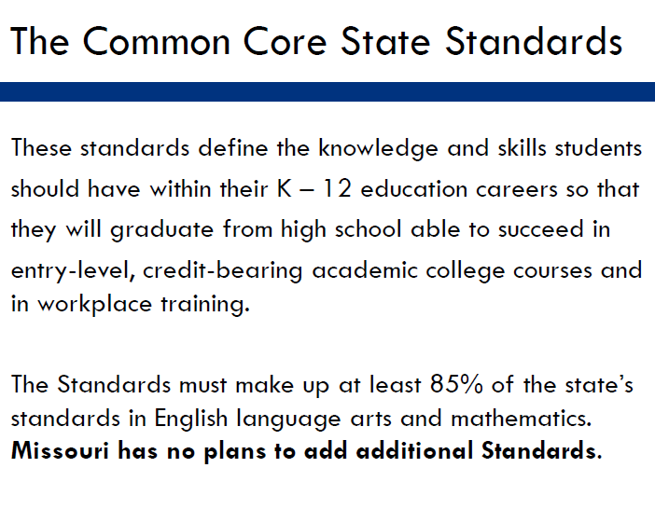
Notes:
States have the right to add standards as long as 85% of them are the CCS. MO has no plans to add additional standards.

Slide 7
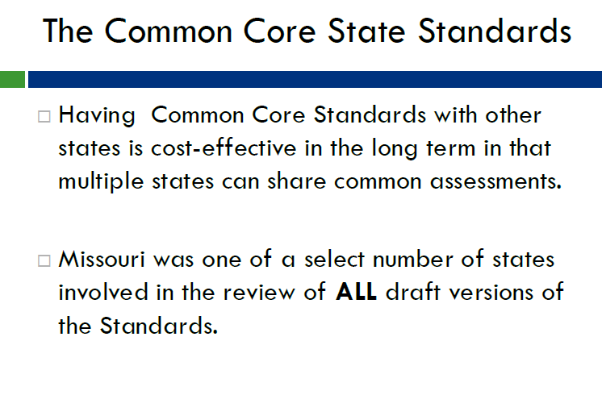

Slide 8
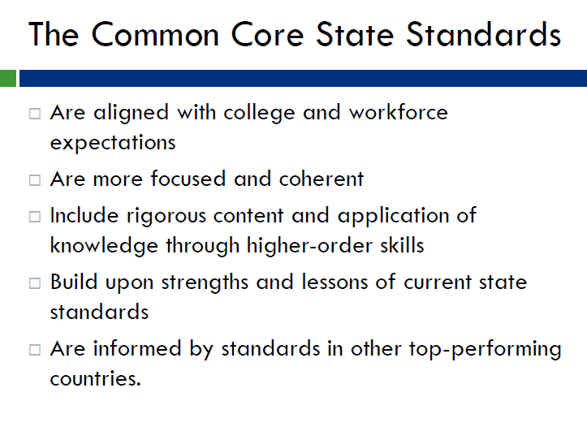

Slide 9
Plan for testing
2012-2013 GLE test blueprints and test design. Any items that align to a CCSS at the appropriate grade-level will be reported in an IBD report to provide your district information.
2013-2014 GLE test blueprints and test design. Will select items that align to both the GLEs and the CCSS as much as possible. Use the crosswalk to see what is in common at each grade and content area. Smarter Balanced field test for many schools. The field test will be online.
2014-2015 Implement online CCSS assessments developed by Smarter Balanced.
-Michael Meunks

Slide 10
Resources Available
DESE Website
East Lynne Curriculum & Instruction Webpage
Getting resources everyday
Various Online Tools
Notes:
Every time I go to the DESE website or check my box… there is SOME sort of resources. Several of the meetings I have gone to have cautioned…Buyer beware! Just because something says that they are aligned to the common core does not mean that it is. Many of the textbooks that say they were “aligned” became “aligned” before the standards even came out. Not that there are not great resources out there, we are going to highlight some of them later this morning. But I did want to show you this new webpage that I created to house some of the things we will be doing. I will be putting things on the server, etc. But I just thought this would be an easier place to locate and well, I can add things to it from the comfort of my home! FLIP CHARTS; pass around.

Slide 11
Misconceptions & Clarifications
Misconceptions and Clarifications
1. Standards are our objectives and what we are to teach.
The skills embedded within the standard is what should drive what we teach and how we assess.
2. The CAS are the same thing as the GLEs… just stated differently.
2/3 is aligned; 1/3 is not aligned. The different and NEW elements of the CAS (and what we need to focus building our instruction and assessment around )are:
    Career Anchor Standards for ELA
    Standards for Mathematical Practices
    Learning Targets
    Depth of Knowledge
Notes:
Let’s take a look at the document itself. You can see that I have put the dividers in your binders. They are separating the MATH, THE ELA, and the APPENDICES A, B, and C. Let’s take a minute and you can label those tabs with the labels that are on your table. The first one is MATH CAS, ELA CAS and then APPENDIX A, B, C.
Now that you have labeled your document lets talk about two misconceptions that are out there. The standards are not our objectives. We need to deconstruct these standards so that we know what we are supposed to be addressing.
Look at Career Anchor Standards
Look at Standards for Math. Practice
NEW: Learning target and depth of knowledge. As we work with deconstructing the standards we will see how these two things come into play and are really what makes the CAS set apart from the GLEs. Yes, we are still covering much of the same “things” but how and when we are going to do it really has changed and as the video mentioned is really a new wave in education. We are not just assigning new names to old things. We are going to have to teach differently, assess differently, and approach how we manage our instruction.

Slide 12
Today’s focus: MATH CAS
GOALS:
  Introduction
      Read introduction
      Choose ONE thing to share out in your group that you think is important, was a new idea you hadn’t considered, you have a question about, confirms what you already know
  See and understand the document
  See and understand the resources available
  Analyze what’s there and what changes have been made to our standards
  Evaluate our instructional and assessment practices
Notes:
Introduction; read pages 3-4 to yourself. Talk to your group/ share out
Progressions document, Math CAS (use tabs if you want to tab off where your grade is or every grade… whatever you want to do. The introduction is followed by the standards for Math Practice which we will discuss in greater detail later.

Slide 13
Three Major Shifts
FOCUS
COHERENCE
RIGOR
Notes:
As we examine this document we are going to see that there are three main shifts that we will see.

Slide 14
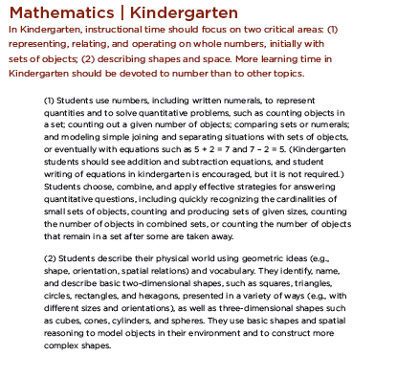
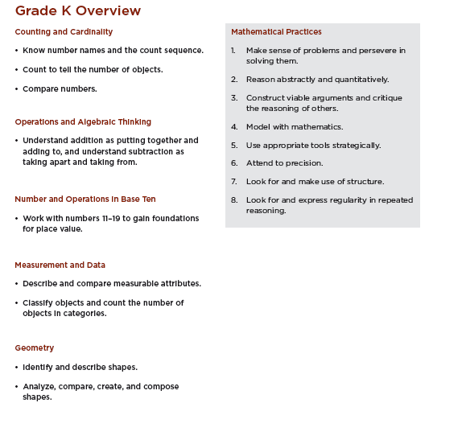
Notes:
Flip to the first page of your grade-level. Each grade level starts out with two things. A Critical Focus and an Overview. I really love the Critical Focus because I think it will be something to keep you grounded in where most of your time needs to be spent.
The overview is also helpful as it clearly defines the domains that are present at that grade level and a short little summary of the clusters that are apart of that domain. Every grade level also includes the list of MATHEMATICAL PRACTICES which I have said we will be looking at shortly.

Slide 15
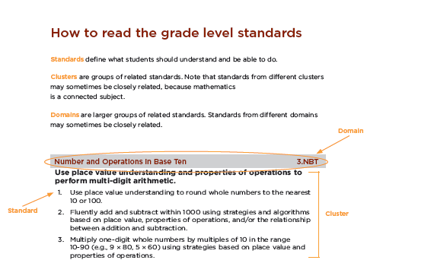
Understanding the Document
Grade level listed first and then domain.
Notes:
Flip to the first part of your grade. Each page is organized by domains, clusters and standards. Just flip through your pages you can see the letter Acronym for each one ties in with the actual domain name (which is not new)

Slide 16
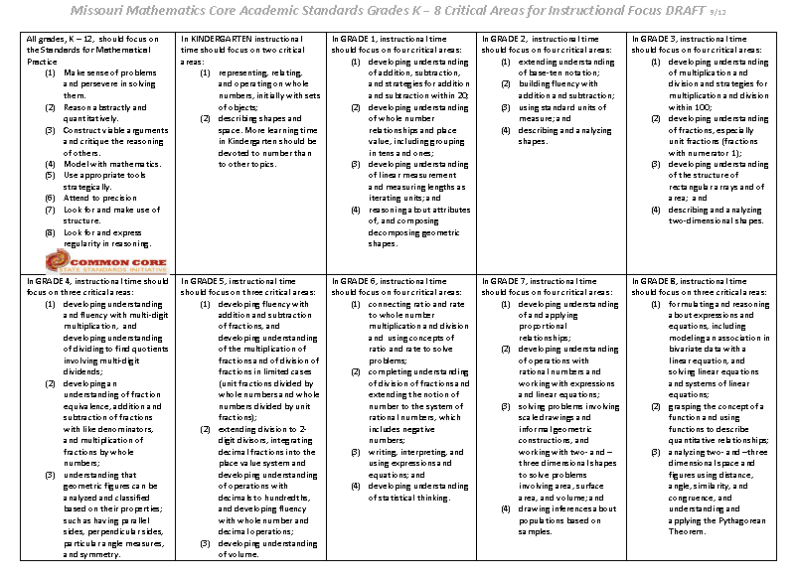
Observations about Critical Focus
Record your observations; Be ready to share out MOST IMPORTANT observation.
Notes:
Let’s take a look real quick at the critical focus for each grade. Take some time to read through your K-2, 3-5, 6-8 focus descriptions. Talk in your group what you see as commonalities, how do they work together, compliment, show progression.

Slide 17
Standards of Mathematical Practice
While the CAS describe what mathematics students should be able to understand and do, the mathematical practices describe how students should engage with these mathematical concepts and skills.
Read, analyze, and summarize the Standards of Mathematical Practice assigned to your group. Be ready to share out your findings.
What do they mean?
What do they entail?
How might that change what we do in the classroom?
http://www.illustrativemathematics.org/standards/practice
Notes:
Assign everyone 3 standards and have them read them as a group and then summarize them, give key points, give examples of how you might use that in the classroom, etc.

Slide 18
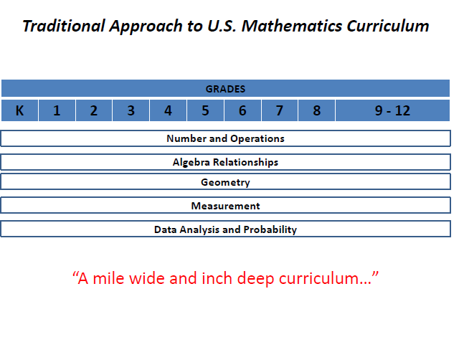
Notes:
handout

Slide 19
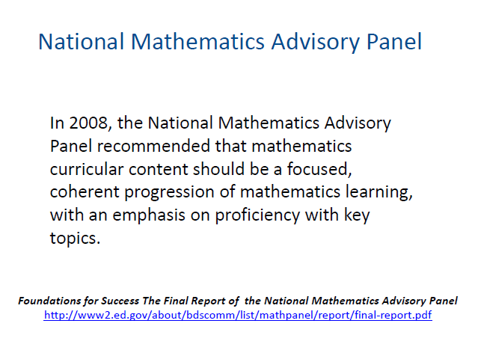
“Any approach that revisits the same topic year after year without closure is to be avoided.”
Notes:
“Any approach that revisits the same topic year after year without closure is to be avoided.”

Slide 20
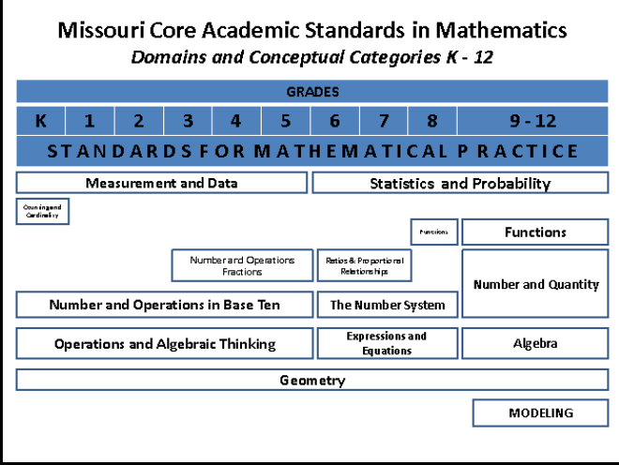
Notes:
When you put them side by side, what observations can you make?

Slide 21
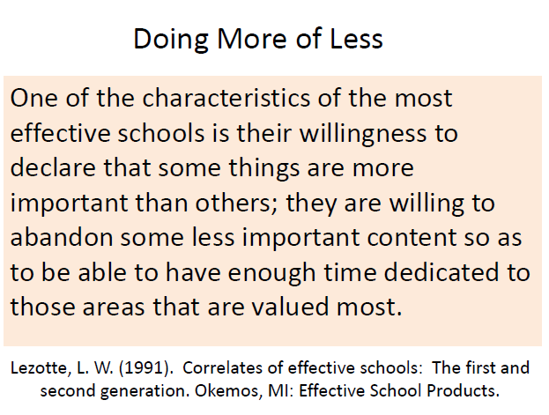
Notes:
I think this will be something that will be important for us to do; let’s see what we have, what we are doing, what do we need to stop, change, amp up, etc.

Slide 22
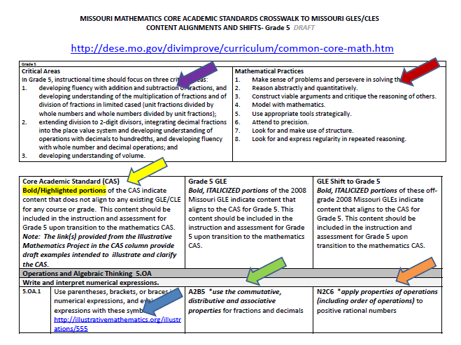
Look for the highlighted bolded areas that are in your crosswalk. Identify three changes you will need to make in order for students to meet the expectations of the standards.
http://www.illustrativemathematics.org/
Notes:
This is another AMAZING document that Missouri has done for its educators. This crosswalk really helps you to see what changes there will be in the CAS. Let’s take a look the document. You actually have the part of this document that is specific to your grade level INSIDE your binder. If you are a non-grade level person then you can look off of someone in your group as we do this. You also have this handout if you want to write notes on it so you can remember what each part is. The first thing it lists are those critical areas of focus. These are the areas that “every second grader needs to leave with” It’s like that platform we saw on the video. These critical areas of focus are the platforms on which students will stop at each year. Then you’ll see the SMP listed as well. The next part is the critical part for you to understand. It lists what is aligned, what is new and what is shifted. Take some time to look at YOUR crosswalk (again NON-grade level, share) Find 3 things that you will need to change either because you need to add it or it has been shifted to you.

Slide 23
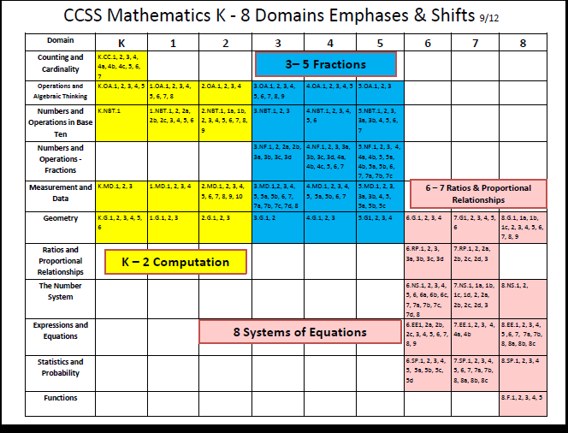
Notes:
While the standards are not explained on this chart it does give you a clearer picture of what to expect.

Slide 24
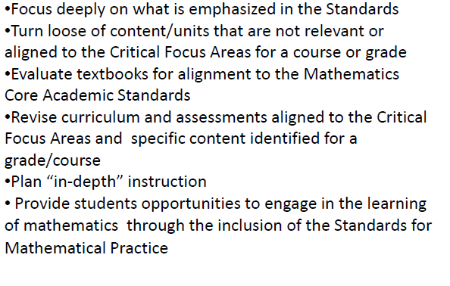
What will we need to do?

Slide 25
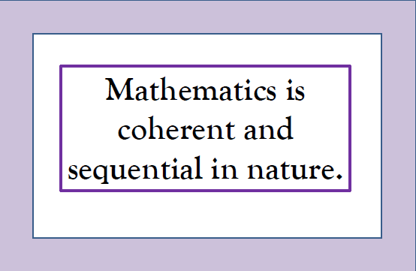
Coherence
Notes:
Grecian Urn ;

Slide 26
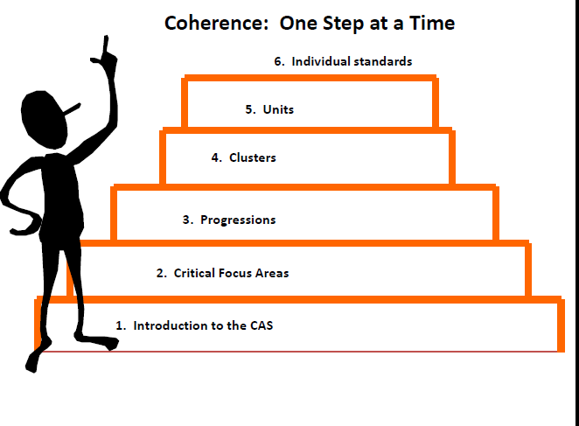
Backwards Design
Look at Progressions Documents – Choose one to read through. Share out in your groups how you might use this document or what observations you can make from this document.
http://www.illustrativemathematics.org/
http://illuminations.nctm.org/Lessons.aspx

Slide 27
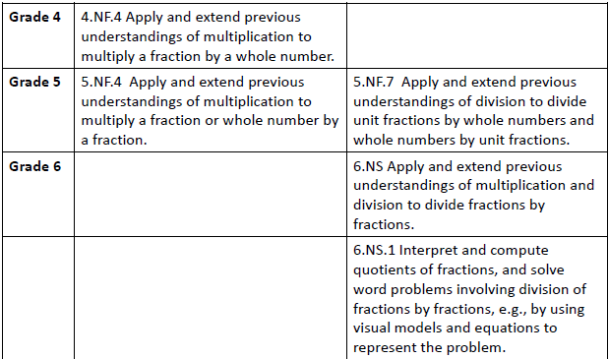
When you take an individual standard and post it as your objective you are actually splitting that standard into pieces and that was not their intention. They are written as progressions.
Each standard is NOT a new event, but an extension of previous learning.

Slide 28
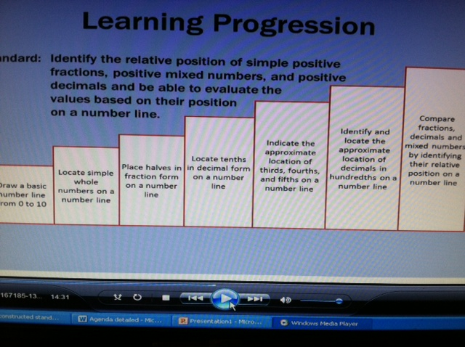

Slide 29
RIGOR
Conceptual Understanding --Fluency--Application
Conceptual Understanding:
  Helping students to develop DEPTH of Mathematical understanding
  More than “how to get an answer”
  Alternate algorithms
  Various Ways to solve a problem; not just the standard algorithm
  Conceptual understanding leads to FLUENCY!
Notes:
Show alternate algorithms! Various ways to solve the problem. Showing various ways deepens their understanding.

Slide 30
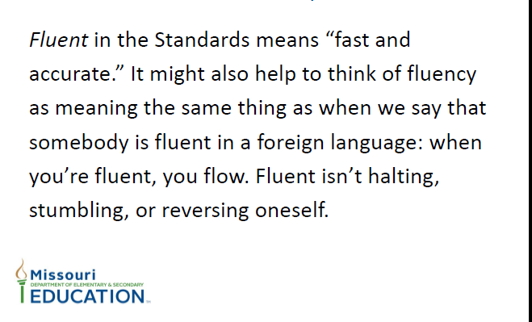

Slide 31
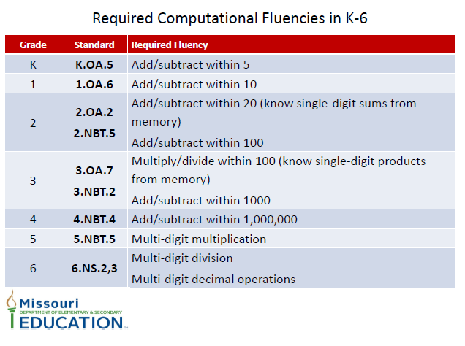
How do we get students to this point of FLUENCY?
Notes:
Handout; QUESTION; What are ways that we can get all students to this level of fluency?

Slide 32
Reflect & Respond
What are you already doing?
What will you need to do differently?
What resources can you use/do you need?
(We will share these after lunch)
      Break→
      Meet at 10:45 in the Computer Lab

Slide 33
Deconstructing the Standards
Each standard has embedded in it skills. Each skill is written at a different learning target level. If we don’t understand these learning targets we will not provide appropriate instruction or appropriate assessment.
LEARNING TARGET
Knowledge-Mastery of sustentative subject content where mastery includes both knowing it and understanding it.
Reasoning- The ability to use knowledge and understanding to figure things out and solve problems.
Demonstration- The development of proficiency in doing something where it is the process that is important; such as playing a musical instrument, reading aloud, speaking in a second language, or using psychomotor skills
Product – The ability to create tangible products, such as term papers, science fair projects, and art sculptures that meet certain standards of quality and present concrete evidence of academic proficiency
Notes:
Show website again (overview)

Slide 34
Deconstruction Process
1. Identify nouns and key phrases to identify key concepts
2. Locate verbs to identify key targets
3. Place the targets into one or more Learning Target Categories
4. Identify the securely held content
5. Clarify terms that may lead to multiple interpretations
6. Construct a list of skills that are essential to become proficient in the identified standard
7. Align skills to learning target and make sure they have the level of rigor necessary to meet the expectation of that standard
8. Write a learning progression that reflects the sequential steps for introducing, developing, and reinforcing concepts and skills
Notes:
This TAKES a ton of time; but they have started the work.

Slide 35
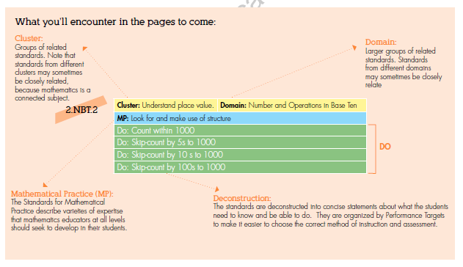
Deconstructed Standards

Slide 36
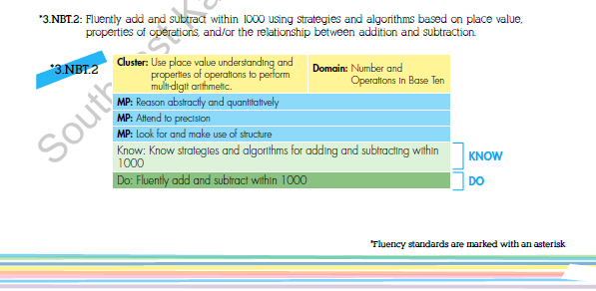
Fluency Standards
Notes:
Toggle over to web page and show PDF search function.
Ctrl F

Slide 37
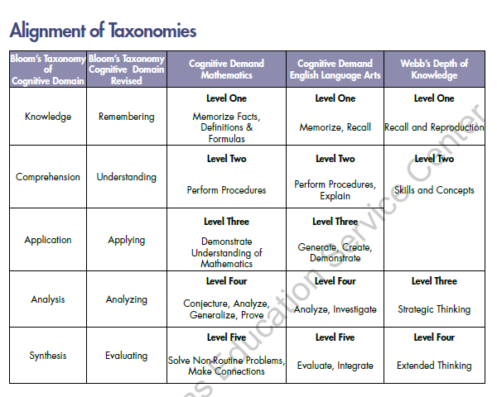

Slide 38
Examine the Deconstructed Standards
Choose a standard to examine.
Work together to create a learning progression that would
  Meet the standard
  Match the learning target
  Include the necessary rigor
  What steps would you need?

Slide 40
Crosswalk, Curriculum, & Changes
Share responses:
What am I already doing now?
What am I going to need to do differently?
What resources can you use/do you need?

Slide 41
Building a Progression
Using ONE domain:
Examine the standard across the grade span (K-2, 3-5, 6-8)
Develop a progression of learning
  What resources would you need?
  How does the previous grade build on yours?
  Read through the progression of that standard

